Slide 1
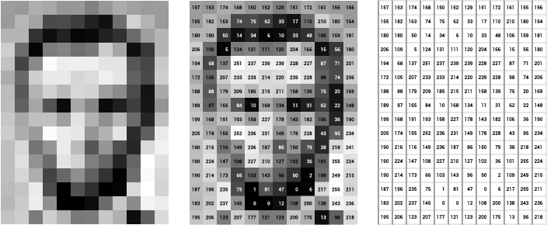
Digital Image: Gray
Image Courtesy: ai.stanford.edu

Slide 2
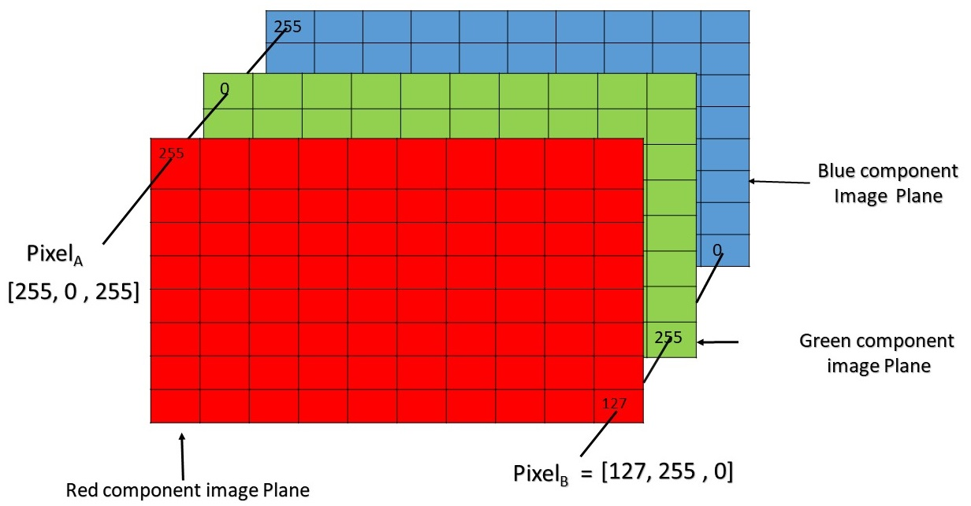
Digital Image: RGB
Image Courtesy: GeeksforGeeks.org

Slide 3
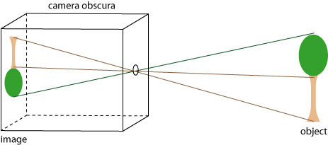
Image Formation
Image Courtesy: Kimberley Photography

Slide 4
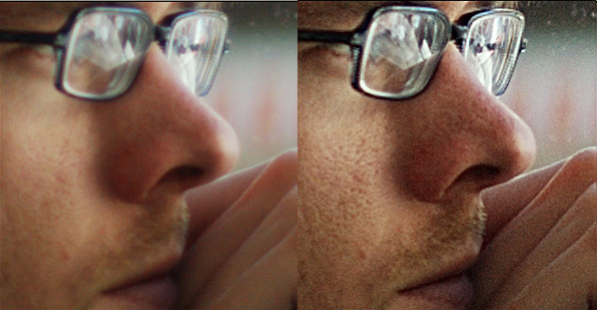

Image Blurring
Image Courtesy: Teckmixer.com

Slide 5
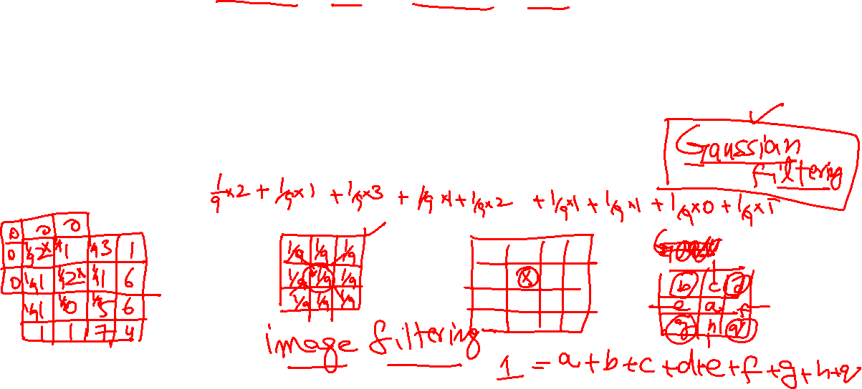
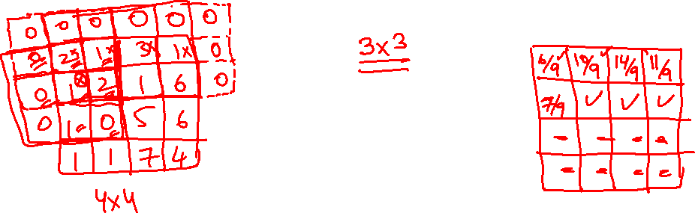
Image Blurring

Slide 6
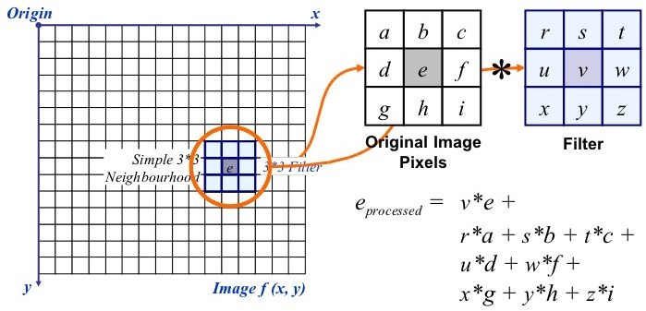
General Image Filtering
Image Courtesy: slideshare.net

Slide 7
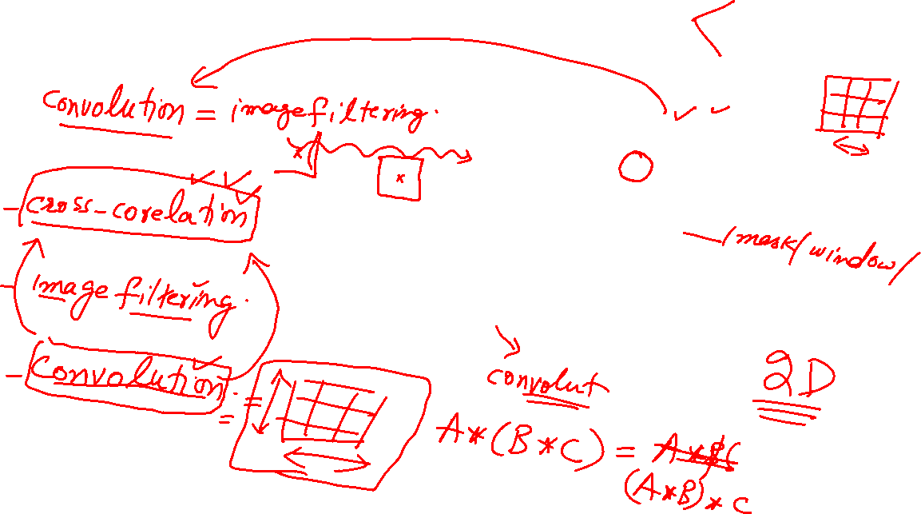
Convolution
Image Courtesy: slideshare.net

Slide 8
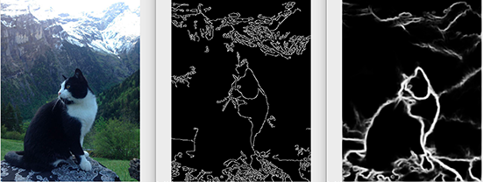
Edge Detection
Image Courtesy: pyimagesearch.com

Slide 9
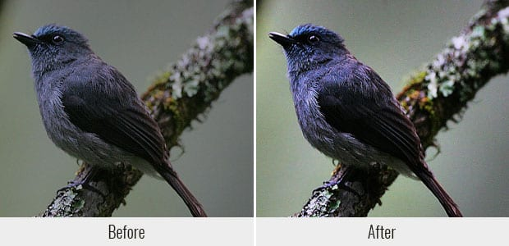
Image Sharpening
Image Courtesy: enviragallery.com

Slide 10
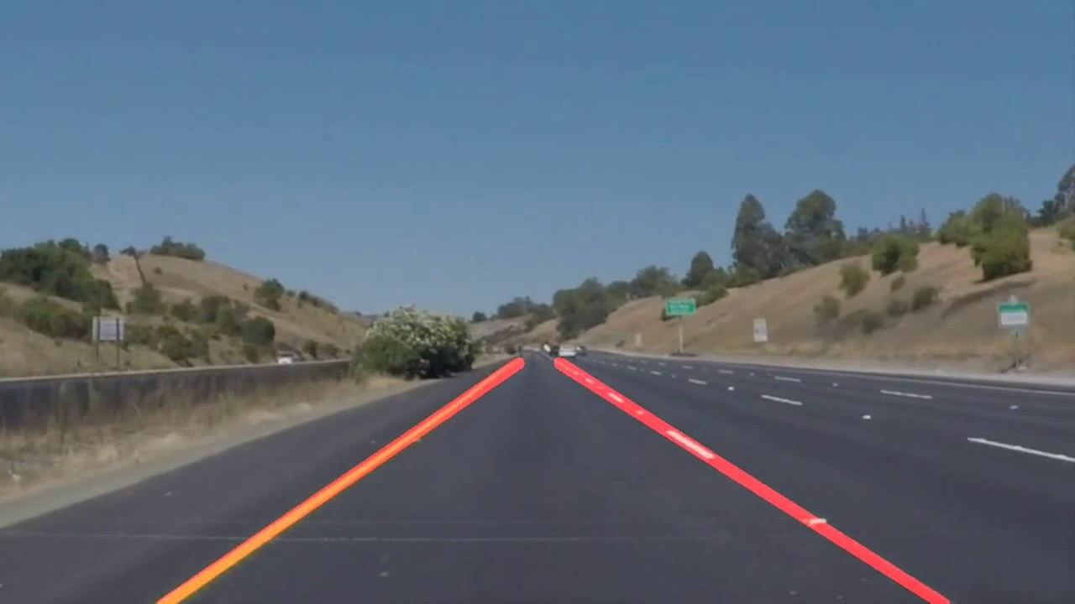
Parametric Shape Detection
Image Courtesy: youtube.com

Slide 11
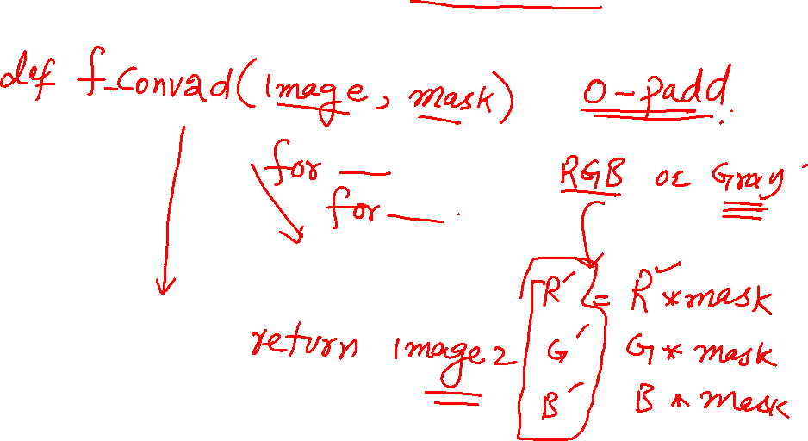
Activity

Slide 12

Object Detection
Image Courtesy: Wikipedia.org

Slide 13
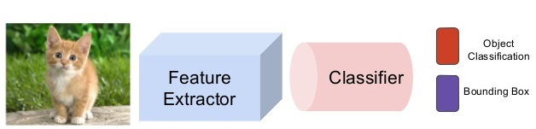
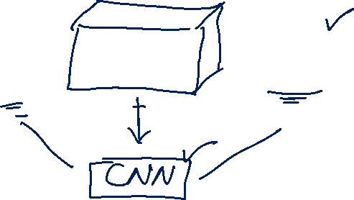
Classification Pipeline
Image Courtesy: slideshare.net

Slide 14
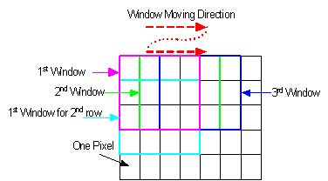
Sliding Window
Image Courtesy: sites.google.com

Slide 15
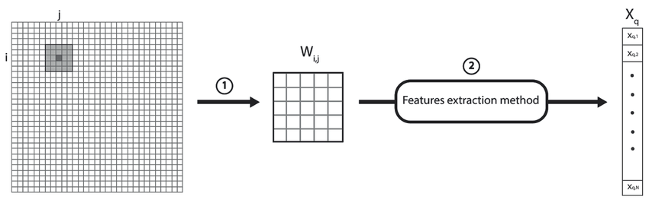
Image Feature Extraction
Image Courtesy: researchgate.net

Slide 16
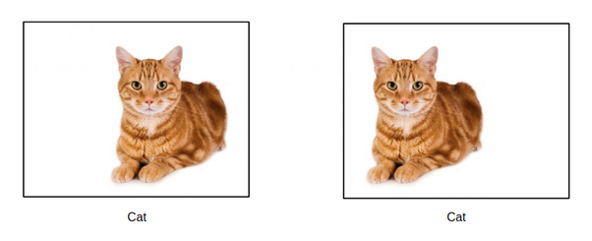
Shift Invariance
Image Courtesy: quora.com

Slide 17
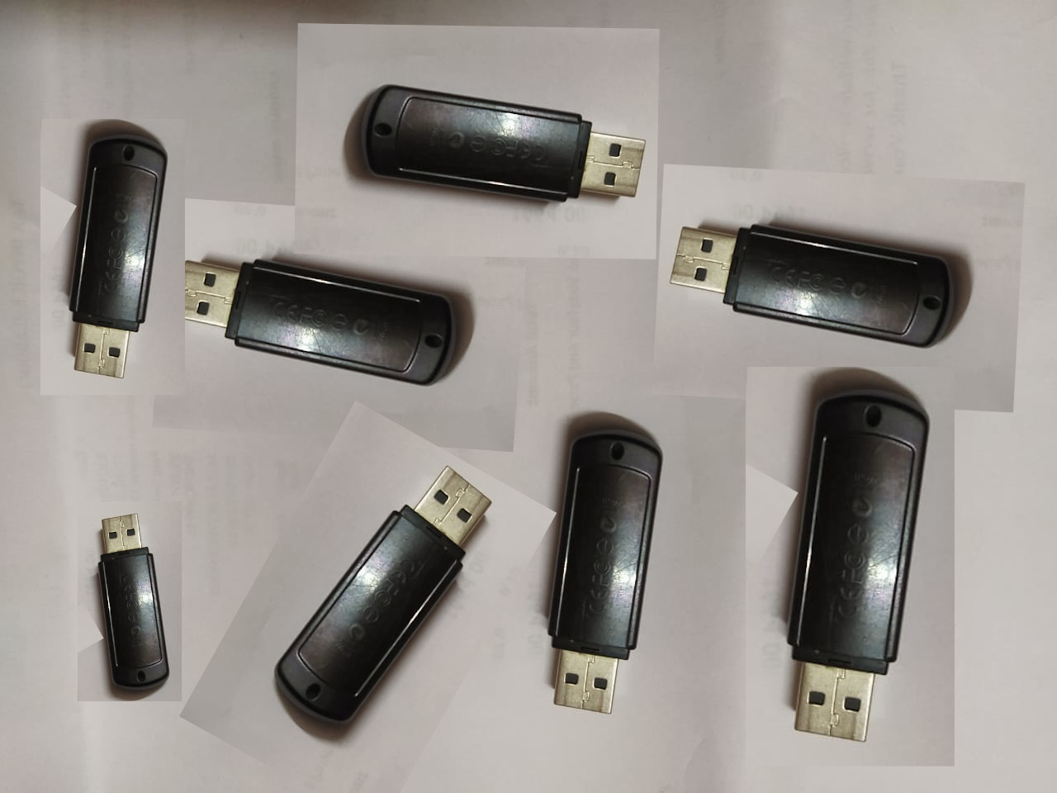
Scale and Rotation
Image Courtesy: stackoverflow.com

Slide 18
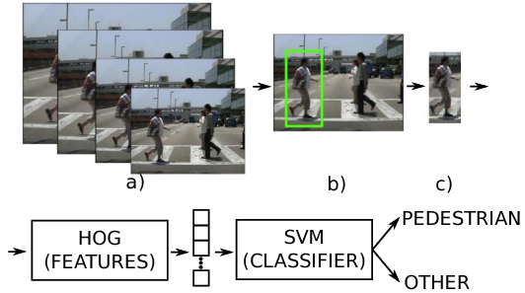
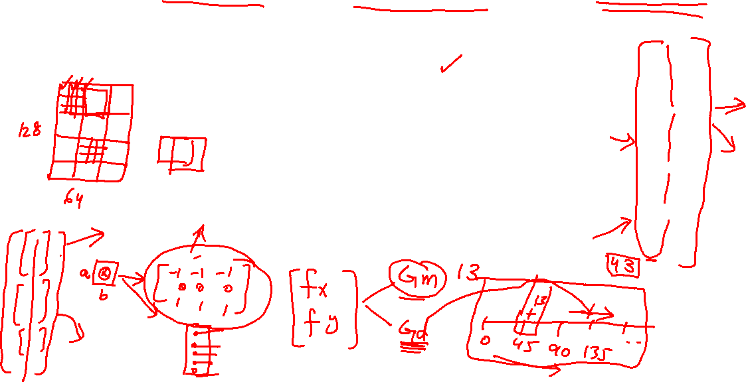
Person Detection: HOG
Image Courtesy: semanticscholar.org

Slide 19
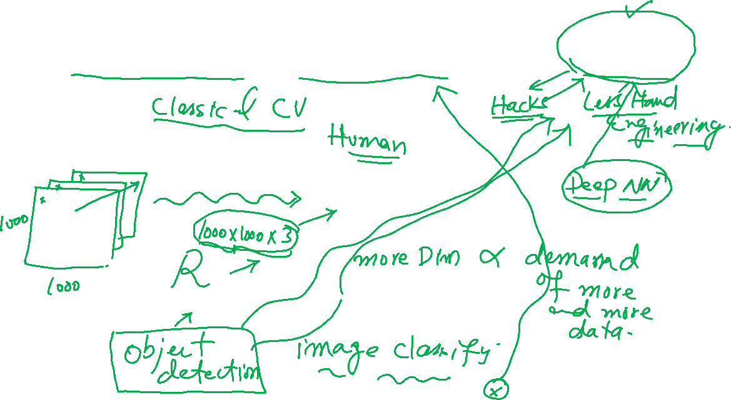
Hand Engineering vs CNN
Image Courtesy: semanticscholar.org

Slide 20
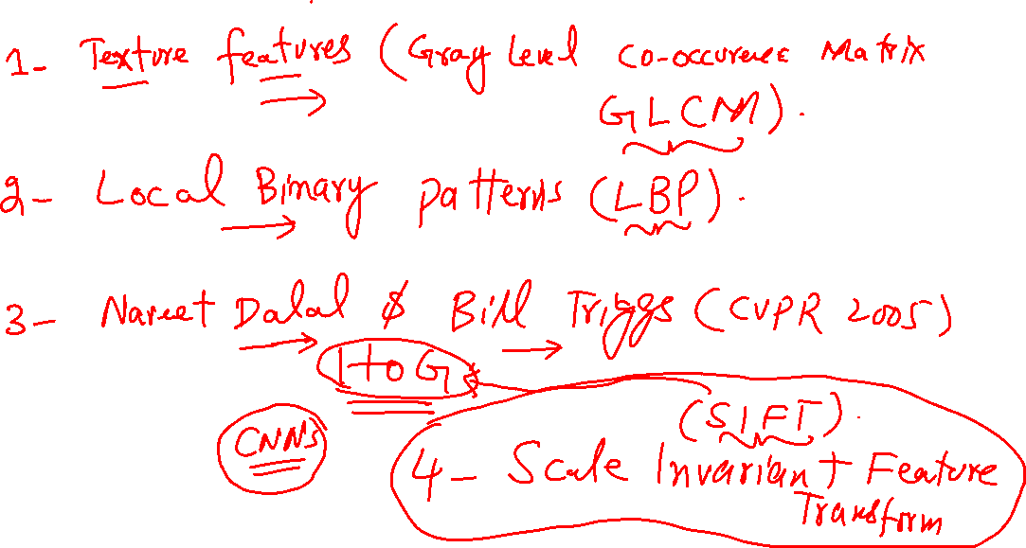
Activity

Slide 21
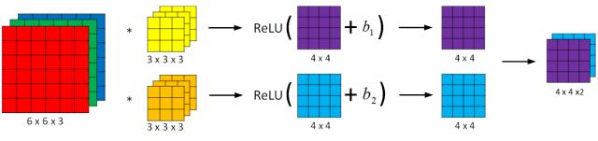
CNN: Filter bank
Image Courtesy: programmersought.com

Slide 22
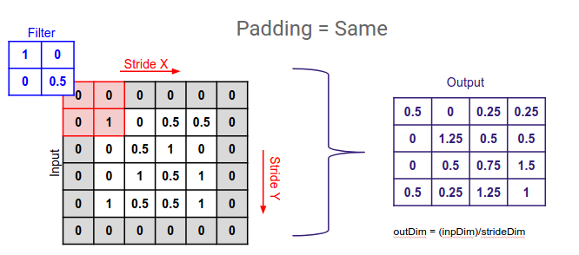
CNN: Padding
Image Courtesy: medium.com

Slide 23
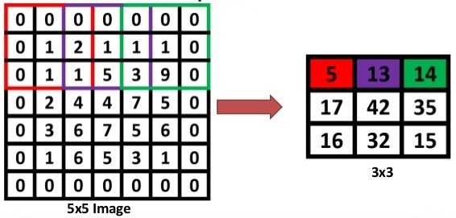
CNN: Stride
Image Courtesy: slideshare.net

Slide 24

CNN: Pooling
Image Courtesy: computersciencewiki.org

Slide 25
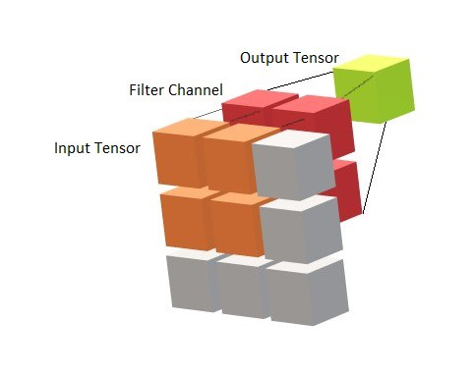
CNN: Tensors and Volumes
Image Courtesy: towardsdatascience.com

Slide 26
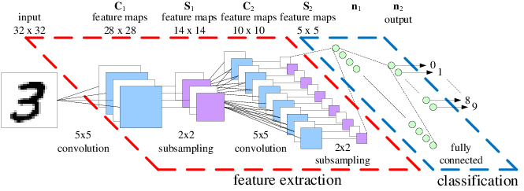
CNN: Architecture
Image Courtesy: researchgate.net

Slide 27
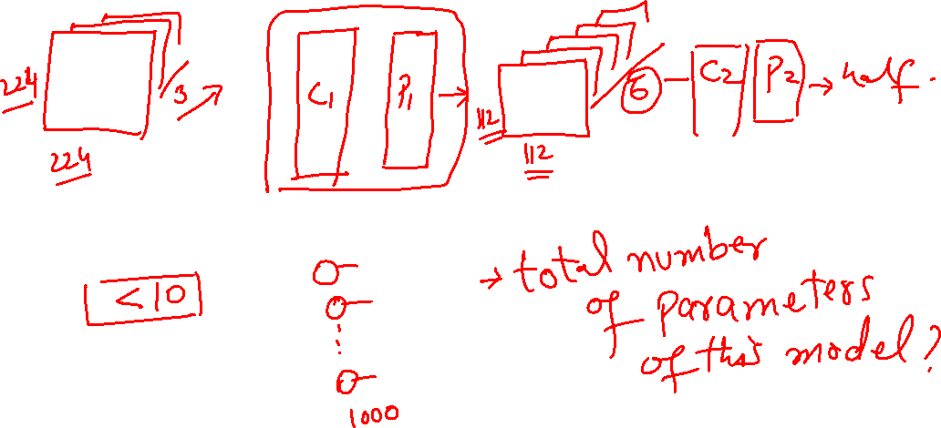
Activity

Slide 28
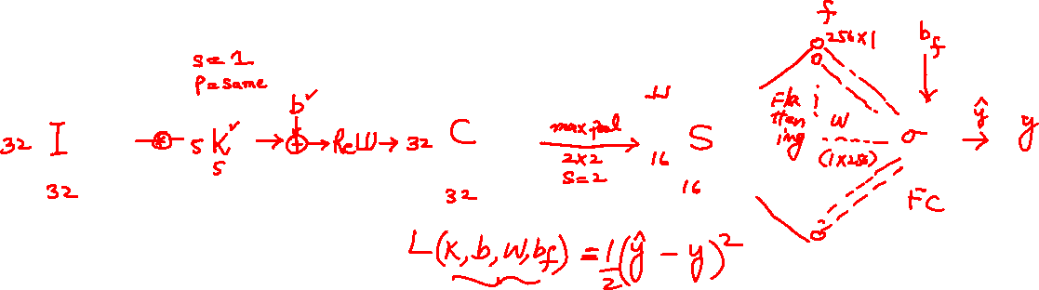
Gradient Descent in CNNs

Slide 29
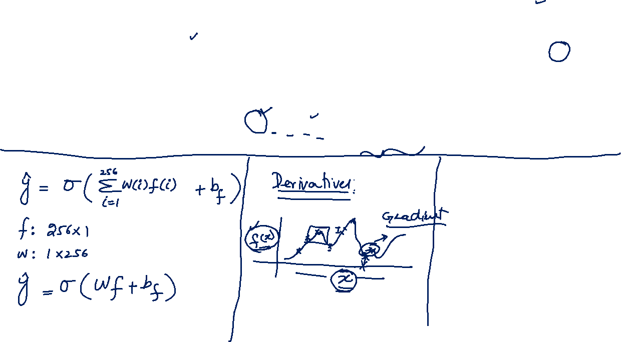

Slide 30
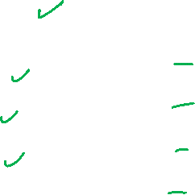
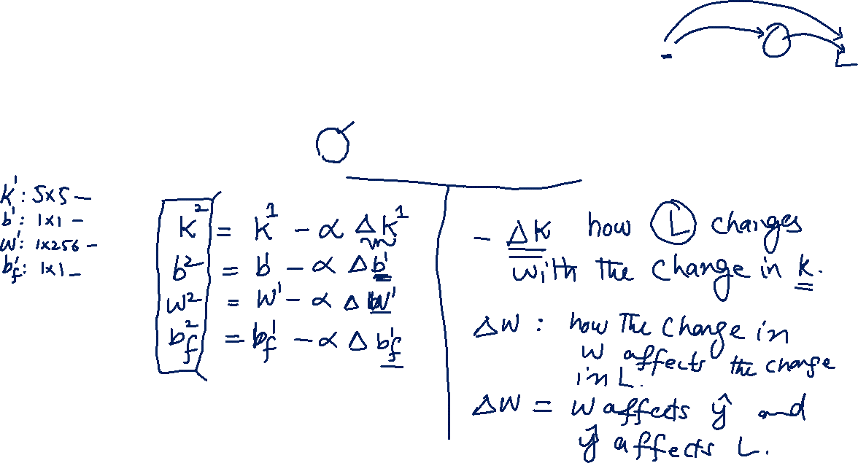

Slide 31
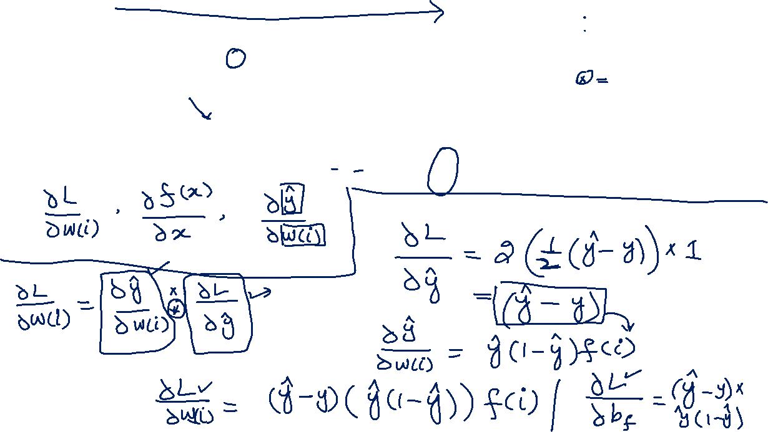

Slide 32
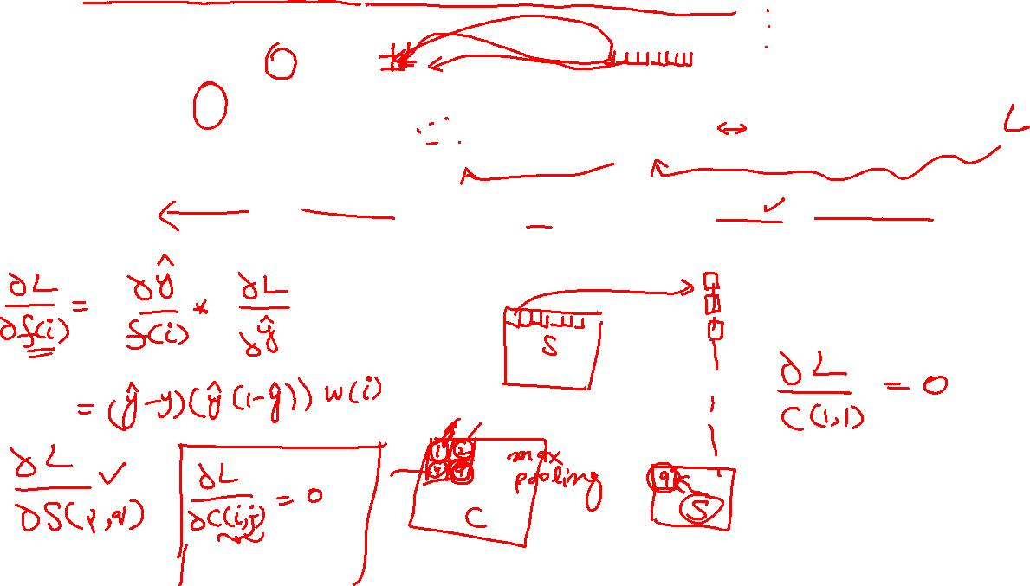

Slide 33
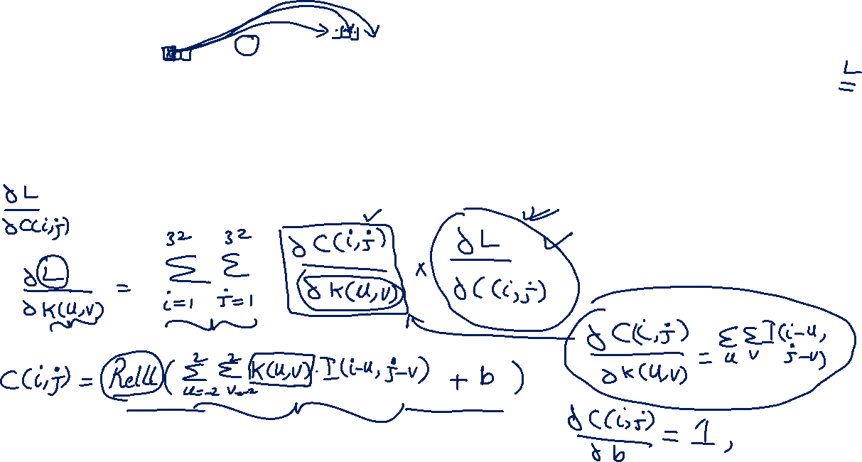

Slide 34
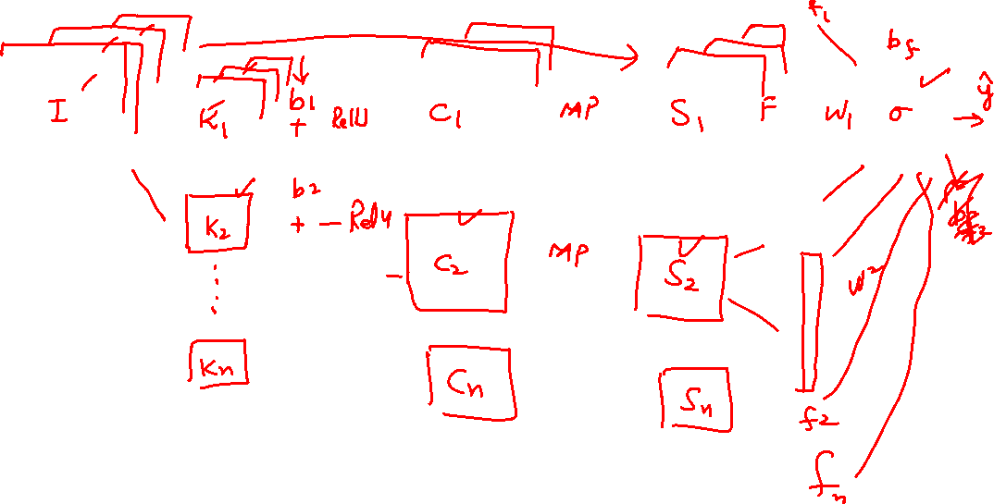
Gradient Descent in CNNs

Slide 35
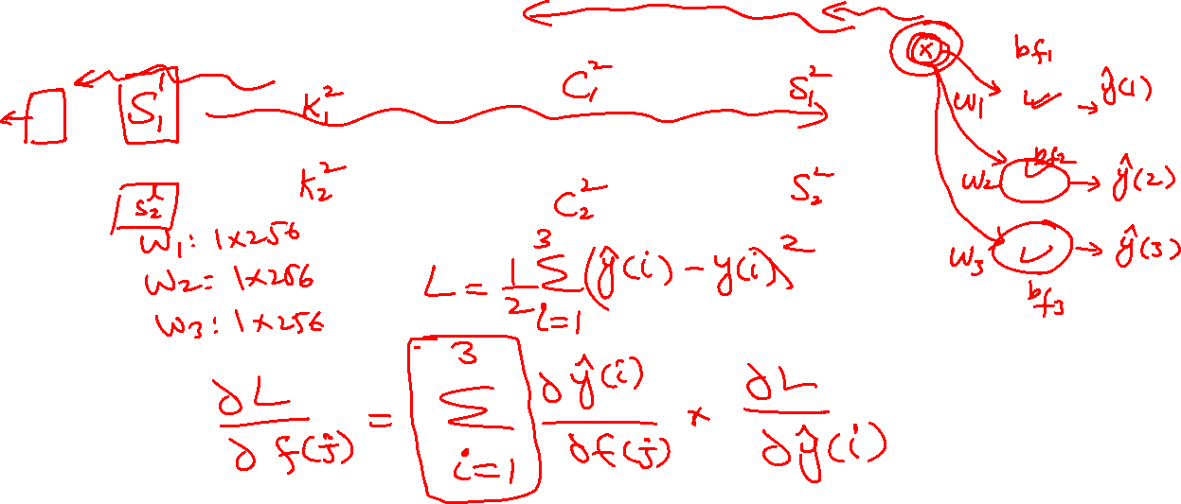
Gradient Descent in CNNs

Slide 36
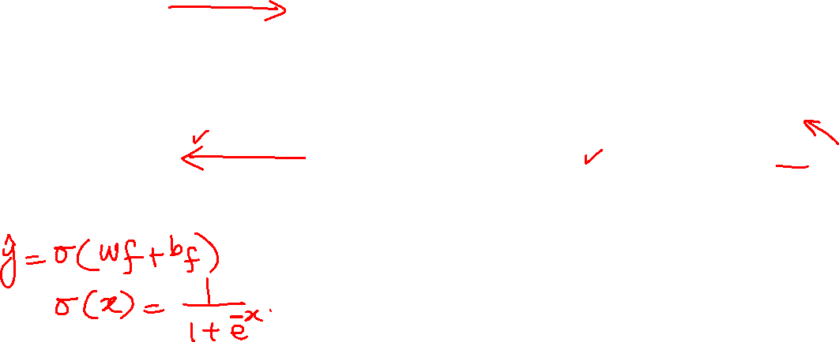
Implementation: Sigmoid

Slide 37
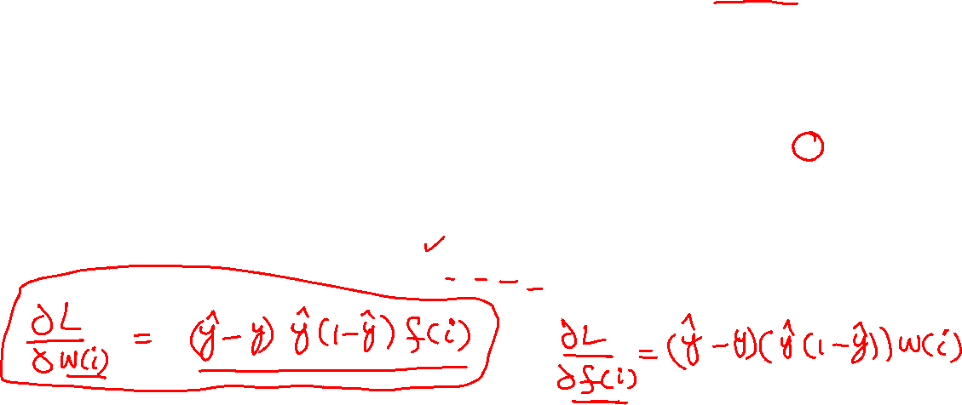
Implementation: Dw

Slide 38
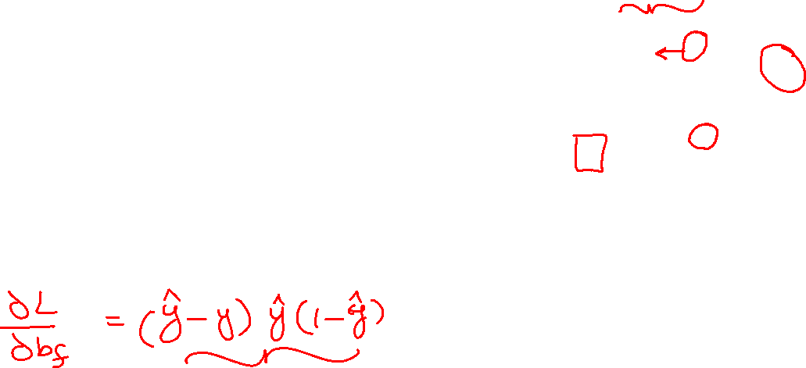
Implementation: Dbf

Slide 39
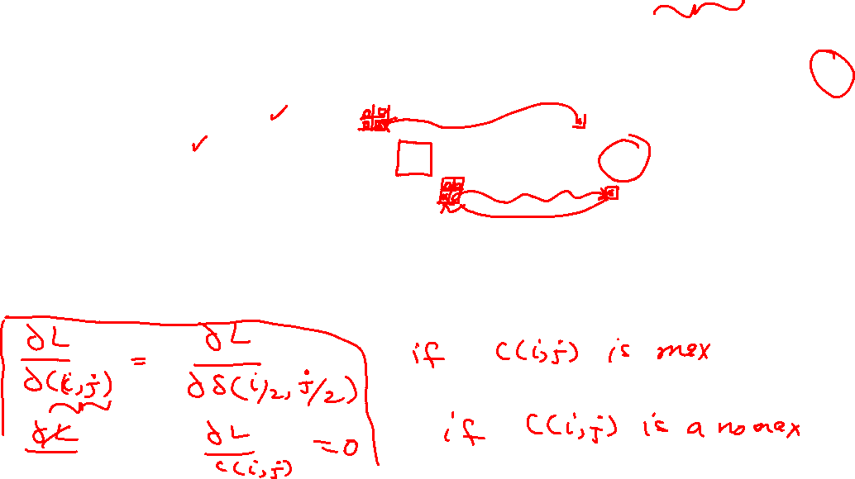
Implementation: DK

Slide 40
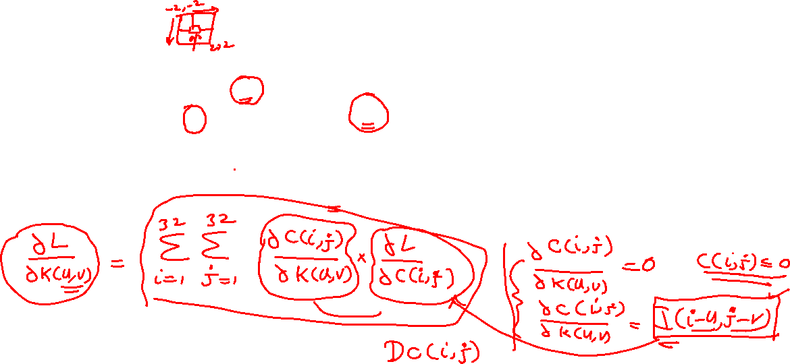
Implementation: DK

Slide 41
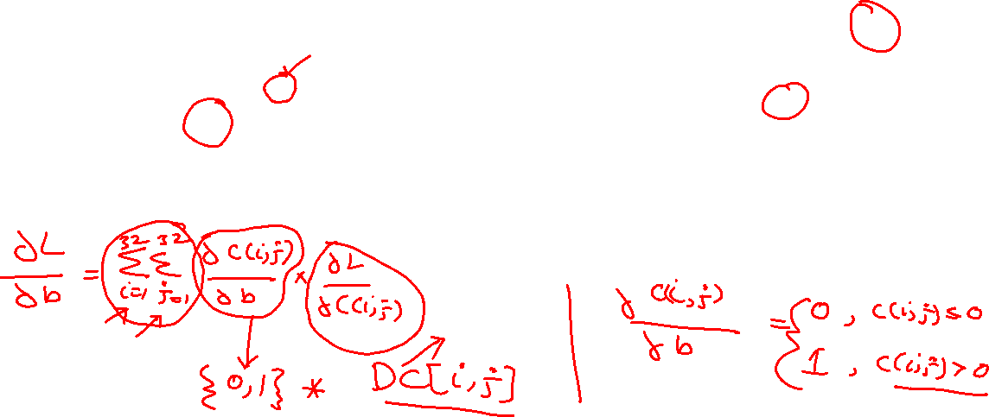
Implementation: Db

Slide 42
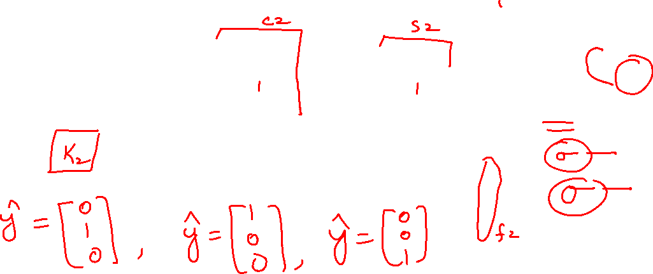
Activity

Slide 43
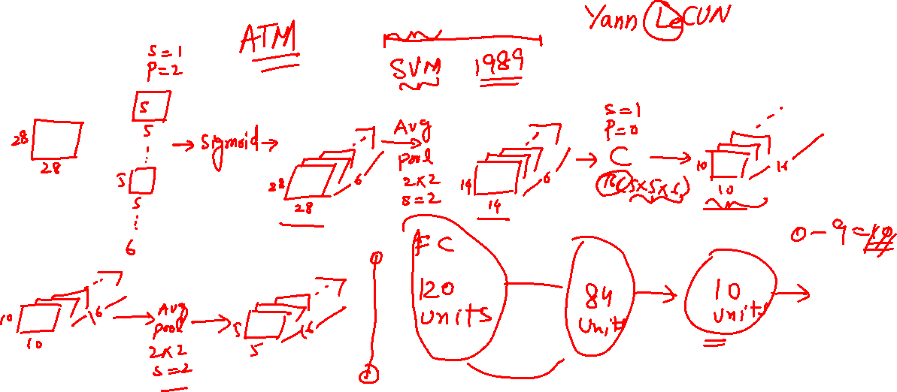
LeNet

Slide 44
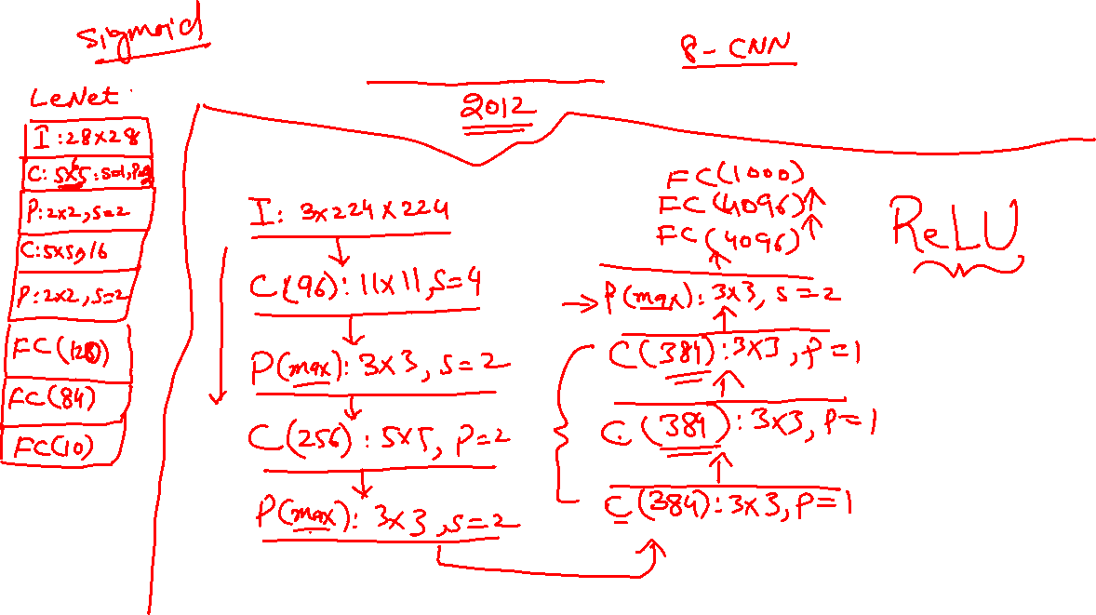
AlexNet

Slide 45
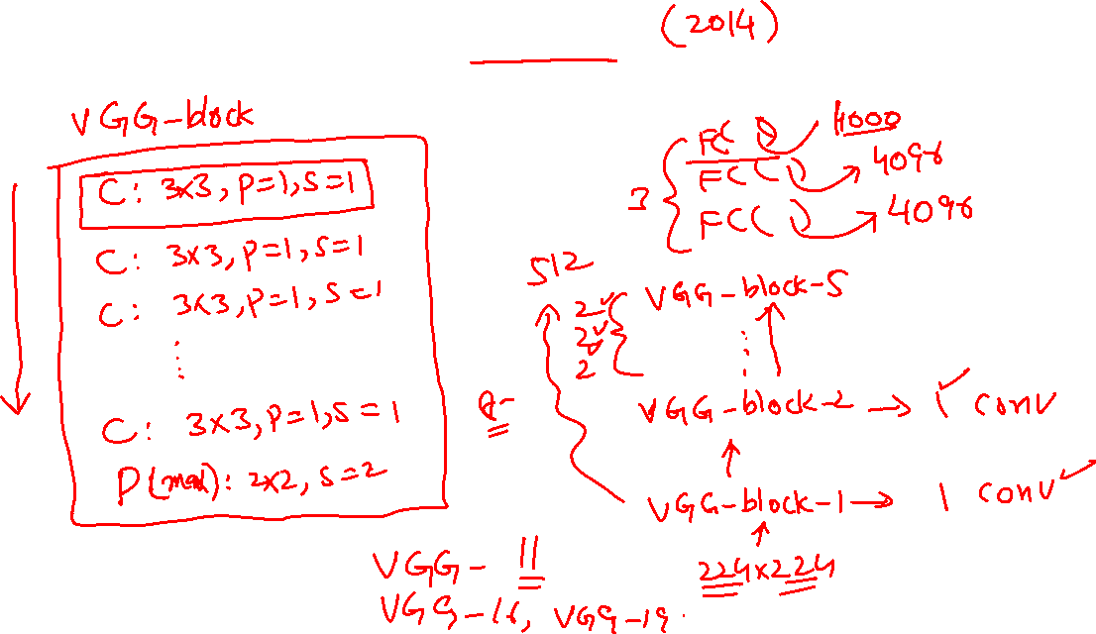
VGG

Slide 46
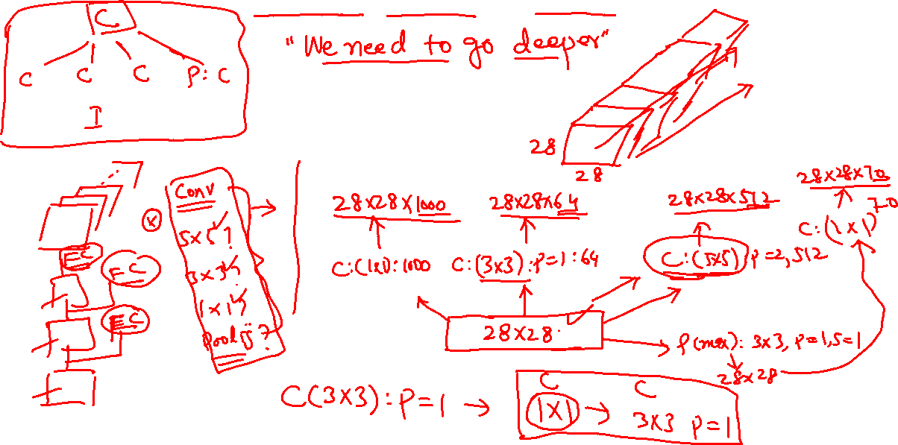
Inception Net

Slide 47
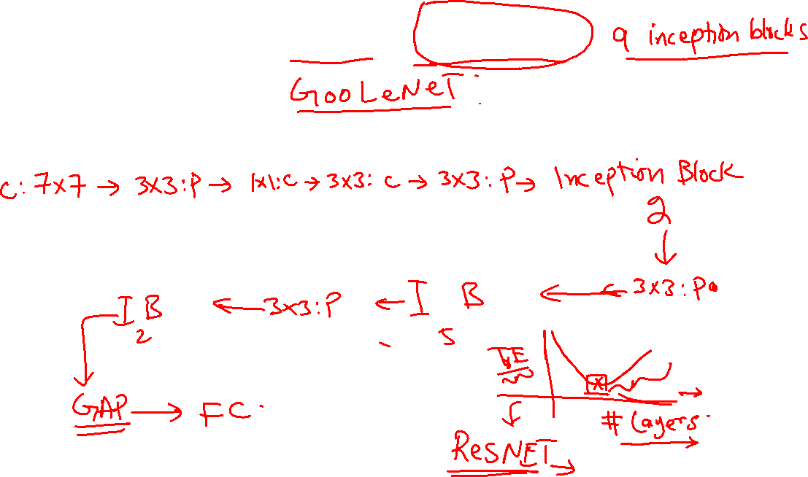
GoogLeNet

Slide 48
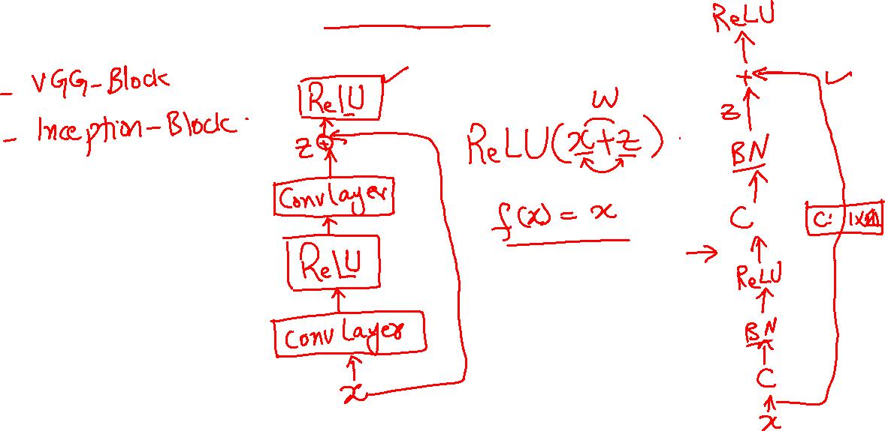
Resnet

Slide 49

Activity

Slide 50

Activity

Slide 51

Transfer Learning
Image Courtesy: learnopencv.com

Slide 52

Why Transfer Learning?
Image Courtesy: medium.com

Slide 53


ImageNet

Slide 54

Practical Transfer Learning

Slide 55
Transfer Learning: Python

Slide 56

Activity

Slide 57
Image Classification

Slide 58

Object Localization

Slide 59

Sliding Window
Image Courtesy: Andrew Ng

Slide 60


YOLO Idea
Image Courtesy: Andrew Ng

Slide 61
YOLO Training Data
Image Courtesy: Andrew Ng

Slide 62

YOLO Anchor Boxes
Image Courtesy: Andrew Ng

Slide 63

YOLO Summary
Image Courtesy: Andrew Ng

Slide 64

Non Maxima Suppression
Image Courtesy: medium.com

Slide 65

RCNN

Slide 66

Activity

Slide 67



Face Verification(siamese network)

Slide 68

Activity

Slide 69



Neural Style Transfer
Image Courtesy: tensorflow.org

